Slide 1
Surface Facility Development Concept
Concept Selection Criteria
CAPEX
Security of Supply & Operations
Minimum Footprint / SD Issues
Schedule
Constructability
Operability & Maintainability
Increase UR / Minimal Turndown

Slide 2
Development Concept Selection
Concept 1 – Individual Bulklines for BB & Elepa Well Streams - Selected Concept
Elepa Wells
2.5km
M/F
28.5km
BFCL Gas Plant at Akabel
Elepa T
BB Wells
9km
M/F
28.5km
Key Merits
Increased UR due to separate manifold & bulklines for the two fields
Increased security of supply as the second bulkline will be available if one bulkline goes down
Concept 2 - Common B/L from Elepa for BB & Elepa Well Streams – Alternative Concept (Dropped)
Elepa Wells
M/F
1.5km
BFCL Gas Plant at Akabel
BB Wells
8km
28.5km
M/F
Common M/F
Key Merit: - Lower Capex, cf Concept-1

Slide 3
Concept Options
Concept 1 – Independent BB & Elepa B/Ls from Elepa to BFCL – Concept Options
Option 1A: BB F/Ls to BB’s M/F at Elepa & Elepa F/Ls to Elepa’s M/F at Elepa – Selected Option
BB
Well 1
3 Nos. 8’’ x 9km F/L
BB
Field M/F
Gas Plant
BB
Well 2
BB
Well 3
Gas Processing Facilities
Train-1: 150 MMscfd
Train-2: 150 MMscfd
Train-3: 150 MMscfd
Fertilizer
Plant
NAG Wells Gas Flow – 300 MMscfd
Gas
20'' x 28.5km B/L
BB/Elepa Interconnectivity Provision
16'' B/L
In-plant Interconnecting Line
Elepa
Well 1
HGOR Wells Multiphase Flow – 150 MMscfd
Gas
Elepa
Well 2
16'' x 28.5km B/L
Elepa
Well 3
Power
Plant
Elepa
Well 4
Elepa
Field M/F
Elepa
Well 5
5 Nos. 6’’ x 2.5km F/L
Condensate
Storage Tanks
Condensate
6’’ x 0.5km
Condensate
Export Jetty
Key Merits | Key Demerits
Flexibility to flow any well through either B/L Ease of operation (All manifolds at a single location in Elepa) Short interconnecting line (< 0.1km) | Higher CAPEX, cf B/L Option, view: 8 long F/Ls vs 2 B/Ls Larger footprint cf B/L Option
8’’ x 17km
Brass
Terminal

Slide 4
Concept Options
Concept 1 – Independent BB & Elepa B/Ls from Elepa to BFCL – Concept Options
Option 1B: BB B/L to BB’s M/F at Elepa & Elepa F/Ls to Elepa’s M/F at Elepa
BB
Well 1
BB
Field M/F - 1
BB
Field M/F - 2
8’’ 1km F/L
Gas Plant
BB
Well 2
8’’ 1km F/L
8’’ 1km F/L
20'' x 8km B/L
Gas Processing Facilities
Train-1: 150 MMscfd
Train-2: 150 MMscfd
Train-3: 150 MMscfd
Fertilizer
Plant
BB
Well 3
NAG Wells Gas Flow – 300 MMscfd
Gas
20'' x 28.5km B/L
BB/Elepa Interconnectivity Provision
16'' B/L
In-plant Interconnecting Line
Elepa
Well 1
HGOR Wells Multiphase Flow – 150 MMscfd
Gas
Elepa
Well 2
16'' x 28.5km B/L
Elepa
Well 3
Power
Plant
Elepa
Well 4
Elepa
Field M/F
Elepa
Well 5
5 Nos. 6’’ x 2.5km F/L
Condensate
Storage Tanks
Condensate
6’’ x 0.5km
Condensate
Export Jetty
Key Merits | Key Demerits
Ease of operation, with BB & Elepa M/Fs at a single location in Elepa Short interconnecting line (< 0.1km) | No flexibility to flow BB wells selectively through Elepa B/L Increased complexity of operations, - one additional manifold for BB., upstream of the interactive M/F at Elepa.
8’’ x 17km
Brass
Terminal

Slide 5
Concept Options
Concept 1 – Independent BB & Elepa B/Ls from Elepa to BFCL – Concept Options
Option 1C: BB F/Ls to BB Field M/F & Elepa F/Ls to Elepa Field M/F
BB
Well 1
8’’ 1km F/L
BB
Field M/F
8’’ 1km F/L
Gas Plant
BB
Well 2
8’’ 1km F/L
BB
Well 3
Gas Processing Facilities
Train-1: 150 MMscfd
Train-2: 150 MMscfd
Train-3: 150 MMscfd
Fertilizer
Plant
NAG Wells Gas Flow – 300 MMscfd
Gas
20'' x 37.5km B/L
BB/Elepa
Interconnectivity Provision
In-plant Interconnecting Line
16'' B/L
Elepa
Well 1
HGOR Wells Multiphase Flow – 150 MMscfd
Gas
Elepa
Well 2
16'' x 30km B/L
Elepa
Well 3
Power
Plant
Elepa
Well 4
Elepa
Field M/F
Elepa
Well 5
5 Nos. 6’’ x 2.5km F/L
Condensate
Storage Tanks
Condensate
6’’ x 0.5km
Condensate
Export Jetty
Merits | Demerits
 | No Flexibility to flow any well through either B/L Increased complexity of operations. Two manifold locations at Bubouwe and Elepa Long interconnecting line (12km)
8’’ x 17km
Brass
Terminal

Slide 6
Concept Options
Concept 2 - Common BB & Elepa B/L from Elepa T to BFCL – Concept Options
Option 2A - BB Flowlines & Elepa Flowlines to Elepa T M/F
BB
Well 1
BB
Well 2
BB
Well 3
Gas Plant
3 Nos. 8’’ x 9km F/L
Fertilizer
Plant
Elepa
Well 1
Gas Processing Facilities
Train-1: 150 MMscfd
Train-2: 150 MMscfd
Train-3: 150 MMscfd
Gas
Elepa
Well 2
Elepa T M/F
Elepa
Well 3
20’’ x 28.5km B/L
Elepa
Well 4
Gas
Elepa
Well 5
5 Nos. 6’’ x 2.5km F/L
Power
Plant
Condensate
Storage Tanks
Condensate
6’’ x 0.5km
Condensate
Export Jetty
8’’ x 17km
Brass
Terminal

Slide 7
Concept Options
Concept 2 - Common BB & Elepa B/L from Elepa T to BFCL – Concept Options
Option 2B - BB B/L & Elepa B/L to Elepa T M/F
BB
Well 1
8’’ 1km F/L
BB
Field M/F
8’’ 1km F/L
Gas Plant
BB
Well 2
8’’ 1km F/L
BB
Well 3
Gas Processing Facilities
Train-1: 150 MMscfd
Train-2: 150 MMscfd
Train-3: 150 MMscfd
Fertilizer
Plant
Gas
20'' x 9km B/L
Elepa T M/F
20’’ x 28.5km B/L
Elepa
Well 1
Gas
Elepa
Well 2
6’’ 1km F/L
16'' x 1.5km B/L
6’’ 1km F/L
Power
Plant
Elepa
Well 3
6’’ 1 km F/L
6’’ 1km F/L
Elepa
Field M/F
Elepa
Well 4
6’’ 1km F/L
Condensate
Storage Tanks
Condensate
Elepa
Well 5
6’’ x 0.5km
Condensate
Export Jetty
8’’ x 17km
Brass
Terminal

Slide 8
Concept Options
Concept 2 - Common BB & Elepa B/L from Elepa T to BFCL – Concept Options
Option 2C - BB B/L & Elepa F/Ls to Elepa T M/F
BB
Well 1
8’’ 1km F/L
BB
Field M/F
BB
Well 2
8’’ 1km F/L
8’’ 1km F/L
Gas Plant
BB
Well 3
20'' x 8km B/L
Elepa
Well 1
Gas Processing Facilities
Train-1: 150 MMscfd
Train-2: 150 MMscfd
Train-3: 150 MMscfd
Fertilizer
Plant
Gas
Elepa
Well 2
Elepa T M/F
Elepa
Well 3
20’’ x 28.5km B/L
Elepa
Well 4
Gas
Elepa
Well 5
5 Nos. 6’’ x 2.5km F/L
Power
Plant
Condensate
Storage Tanks
Condensate
6’’ x 0.5km
Condensate
Export Jetty
8’’ x 17km
Brass
Terminal

Slide 9
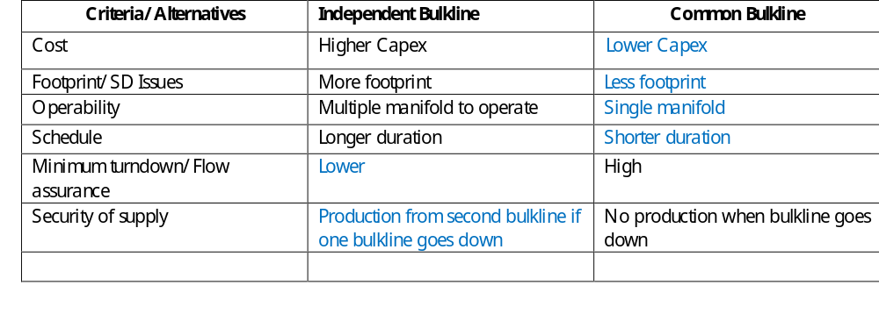
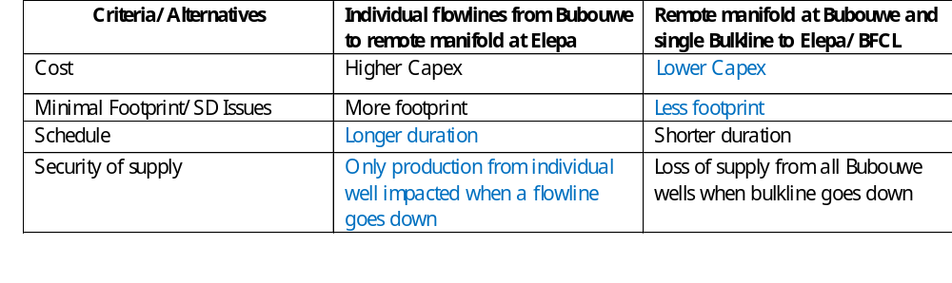
Concepts and Options
Criteria / Alternatives Matrix
Bulkline
Flowline

Slide 10
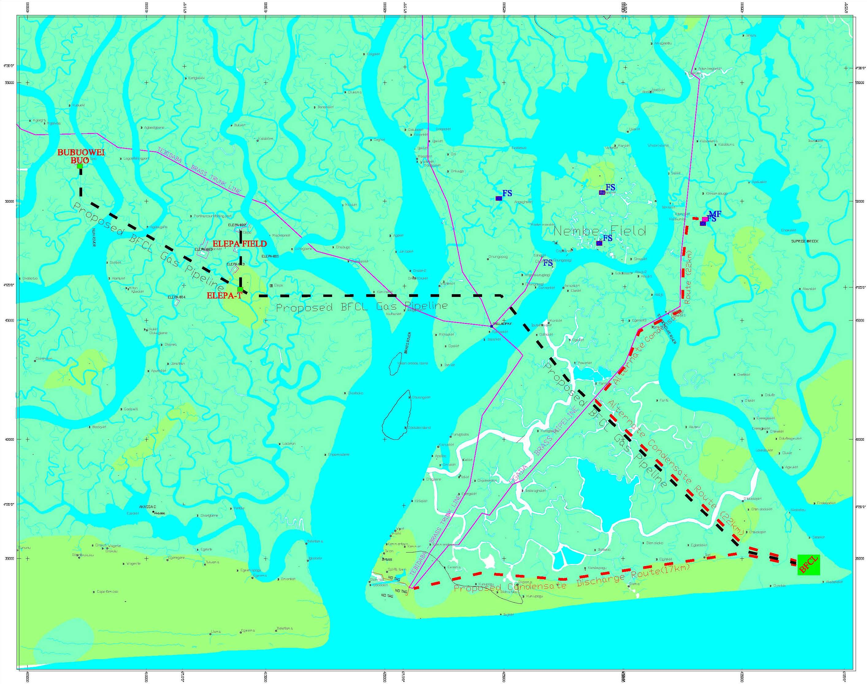
Selected Pipeline Route

